Slide 1
Kafka
Notes:
Minimalist ppt design (naaah, slides should be heavy -- this is a tech presentation -- Steve Job’s isn’t the guy to get inspired fromhere :))
Separate main topics by having a title slide of their own
Images that convey the idea, a single line of text indicative of the most important point only to be conveyed and kept in mind
Text in speaker notes area (i.e here)
Why prepare this presentation:
* Because I’ve never given one
* Presenting is a skill, and one that is repeatable, once learnt you can repeat them, give more of them and charm
* This gives an learning experience of how to deliver/convey your ideas, how to flow the stories which is important
Remember “How to win friends and influence people” by Dale Carnegie
Feedback:
Correlation with Kafka?
How compaction works?
Partitioning and throughput relation?
Summary slides before delving into the topic
Slides should be heavy (everything I talk about should be present as slides -- not as speaker notes -- helps me too)
List problems then solutions
To be covered: quorum sets vs ISR
More details on sequential ids when talking about idempotent producer
Putttttt every damn thing you’ve learnt!!!
Try to give a logical explanation of everything you “fact out”
Take multiple slides over the same topic if needed, but never cut corners (example compaction slides)
Too much info? Make sure you mention atleast the things that otherwise wouldn’t look like a shock?
Or maybe doubt you..”oh but the speaker showed an image where every index is stored”

Slide 2
Index
The Data Driven Enterprise
The Data Integration problem (Why Kafka was born)
At its core (Storage abstraction)
Retention policies
Scaling the log
How data consumption scales
How Kafka tracks consumers
Demo
What’s next
Notes:
A lot of times, you won’t be satisfied because really you didn’t order the topics well :) happier now?

Slide 3
Streams are everywhere
Offer discounts on last 10 product views every once in a while
Running count of Ad clicks
Notes:
Get adjusted to idea of streams
Special nature/kind of data called streams

Slide 4
The Data Driven Enterprise
“Data really powers everything that we do” - Jeff Weiner, CEO LinkedIn

Slide 5
Real time stream of events trigger various backends
Updating my job on Linkedin
“People who work at Morgan Stanley”
Update search indexes
(Elastic Search)
“Congratulate Rohan for a new
position at Morgan Stanley”
My connection’s news feed
(Hadoop batch job)
“Suggested connections”
Updated Social Graph

Slide 6
What is Kafka?
Kafka is a streaming platform
Ingests high velocity/volume of streaming data
Stores it in a fault-tolerant way
Lets it be consumed at chosen pace
Provides DSL to apply transformations (stream processing)
More than a messaging system

Slide 7
The Data Integration Problem
Notes:
Let’s understand how this powerful abstraction solves even bigger problems
Explosion of specialized data systems:
- Elastic search for keeping your search index (someone searching “People who work at Morgan Stanley” should show me up
- Hadoop for batch processing (publishing news feed on my connections “Congratulate Rohan for a new position at Morgan Stanley”)
- Social Graph (to maybe traverse and show up on my feed as “Suggested connections” once I joined Morgan Stanley)
You need to get data IN as well as data OUT of such systems
Imagine I just graduated out of college and I updated my job as Morgan Stanley on LinkedIn
Let us think what are various events that this event would trigger (see ^^)
So the source of this event (“JobUpdatedEvent”) would need to go in each of these systems that know what resulting events have to be triggered.
So there needs to be a data pipeline/carrier of data between such systems (integration)
Data source that gives the data and the services that need to take advantage of data needed to be integrated with such data systems
(Putting configuration for each of these to do the data loads)
For example, a SearchService would consume search data indexed by Elasticsearch and hence would need to know how to load data from it and the same time the front end service getting “NewAccountCreatedEvent”, “NewJobEvent” would want to load these events/update the indexes maintained in Elasticsearch
https://engineering.linkedin.com/distributed-systems/log-what-every-software-engineer-should-know-about-real-time-datas-unifying

Slide 8
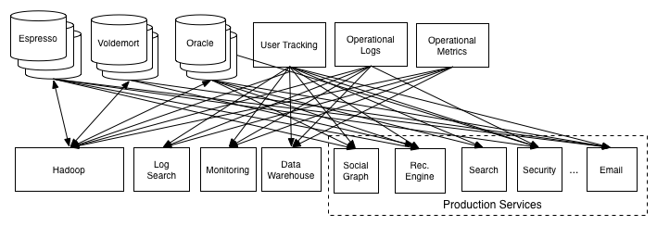
Data Pipelines with advent of specialized data systems have been messy
Every kind of data needs its own special modelling!
That’s why we have Elastic Search, NoSQL, Relational, Hadoop etc
Notes:
User Tracking lets say is the service that is receiving those job updates
We got many backends to churn this
New new backends would ask us to add a hook and please put data into their systems
..really? Just let user tracking expose a REST API?
Okie so what about the data in midst? Where backends weren’t polling you?
I save it...okie..so you take all the load of scaling yourself, etc etc?
(Well this is exactly what Kafka is doing for you, but taking the burden away :))
Or User Tracking service saves it’s messages to MQ? ..again yes..with this slide we’re hinting towards going to a “messaging middleware”
But why not MQ then?
Because it doesn’t scale well...we’ll see
Event streams are on the rise
Let’s take an example of another flow:
The previous slide had just one flow! For example, maybe on page load, JS code requests for an ad impression, you need more tracking on that separately, was the ad clicked on, how many times the ad of a particular company was shown, security system that makes sure the company whose ad is being published isn’t cheating by purposely making the ad popular by clicking on it by bots
recommendation system (this person is similar to this, clicked on this ad, hence lets recommend the same job (showing ads) to this other person too)
the security system
the job poster analytics system

Slide 9
Problems
Source and Sinks:
are tightly coupled hence can’t evolve independently
“Hey Team UserTracking, could you please add a hook to let us load your stream into Hadoop?”
need to understand disparate backends:
How-to-integrate, load data into sink
repeated worries of: what if sink is down? long responding sink?
no single source of truth
Oh all we need is a messaging middleware...yes that’s where we’re headed...but a better one
Notes:
Event streams are on the rise
Let’s take an example of another flow:
The previous slide had just one flow! For example, maybe on page load, JS code requests for an ad impression, you need more tracking on that separately, was the ad clicked on, how many times the ad of a particular company was shown, security system that makes sure the company whose ad is being published isn’t cheating by purposely making the ad popular by clicking on it by bots
recommendation system (this person is similar to this, clicked on this ad, hence lets recommend the same job (showing ads) to this other person too)
the security system
the job poster analytics system

Slide 10
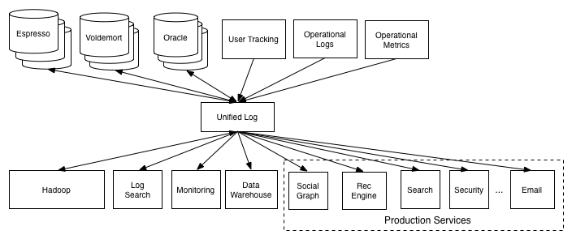
Data pipelines with log as the backbone
Notes:
The idea is that adding a new data system—be it a data source or a data destination—should create integration work only to connect it to a single pipeline instead of each consumer of data
Q:How does the log help here?
A:
- Hence makes data integration easier, since the destination systems need not know “how-to-integrate” with source system. They just need to integrate with the log (not every service needs to know how to put data to Hadoop, Elasticsearch, etc)
- Acts as a buffer making data production asynchronous from data consumption (consumers can crash, go for maintenance come back and resume)
- Sort of flow control (varying consumer consumption rates)
- Elasticsearch indexes need to be updated real-time, but maybe Hadoop jobs only tap in once a day
- This is how it becomes the heart of “data flow”
By writing to the log, we decouple the consuming systems and it becomes a more “receiver-driven flow” since the consumers consume the log themselves, when they want to

Slide 11
Advantages
Persistent log gives us:
receiver driven flow where consumers can crash, goto maintenance mode, later resume
source only needs to know how to integrate with the log
flow control for varying consumption rates:
Search indexes need quick updates
Hadoop jobs only tap nightly
source/sinks can evolve independently
Notes:
The idea is that adding a new data system—be it a data source or a data destination—should create integration work only to connect it to a single pipeline instead of each consumer of data
Q:How does the log help here?
A:
- Hence makes data integration easier, since the destination systems need not know “how-to-integrate” with source system. They just need to integrate with the log (not every service needs to know how to put data to Hadoop, Elasticsearch, etc)
- Acts as a buffer making data production asynchronous from data consumption (consumers can crash, go for maintenance come back and resume)
- Sort of flow control (varying consumer consumption rates)
- Elasticsearch indexes need to be updated real-time, but maybe Hadoop jobs only tap in once a day
- This is how it becomes the heart of “data flow”
By writing to the log, we decouple the consuming systems and it becomes a more “receiver-driven flow” since the consumers consume the log themselves, when they want to

Slide 12
An example to help us imagine

Slide 13
Calculator as a Service
Webapp hosting + , - , * , /
Stream of operations:
+124, -38, /5, *996, *2312, *922337203685477580895, +6, -454, /15423,....
Team A:
Computes the stream
Team B:
That’s a big number, Team A must’ve had to use BigIntegers.
I’m gonna charge you a bit now.

Slide 14
At its core
Notes:
* At its core, we mean what does the broker internals look like *
First idea to give out: The powerful storage abstraction
Second: How it becomes the heart of data flow/data pipeline and solves the integration problem
https://engineering.linkedin.com/distributed-systems/log-what-every-software-engineer-should-know-about-real-time-datas-unifying

Slide 15
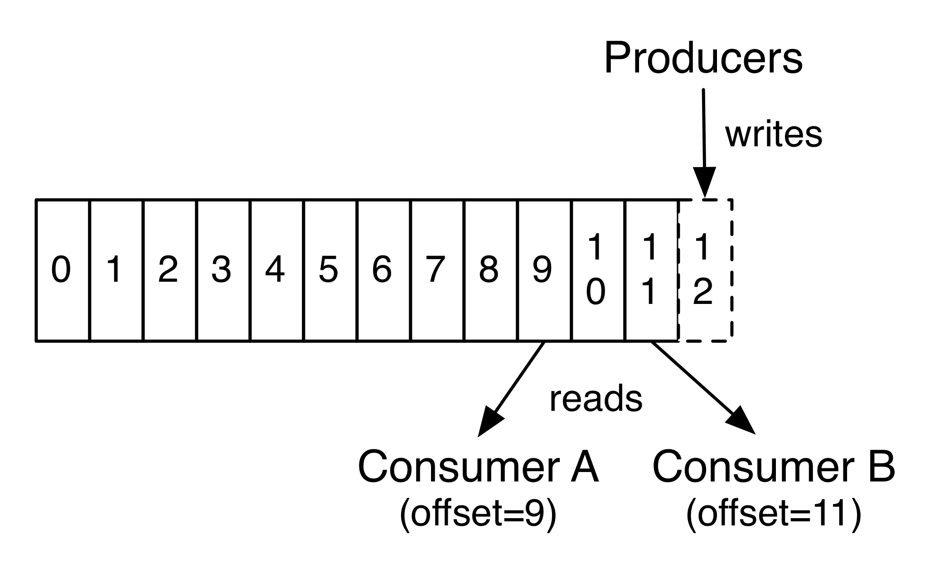
It is just a log storing all events
Notes:
At its core, Kafka is a log. ( hosted on a broker -- server on which Kafka runs is called a broker)
A log is an append only, totally ordered sequence of records, ordered by time
(this is the abstraction the producers and consumers deal with)
Log is ubiquitous in all data systems
Let’s think about databases:
* Haven’t we seen a log before in databases? We have right? We record changes in transaction logs before applying them, so that we can later apply them when committing and also for recovery
* Some databases even use the concept of “changelog” or change stream to maintain replicas
(you think why not the replica querying the primary db frequently to fetch all records and save it in itself?
Querying all records would be heavy! Who knows if the no of records has also kept increasing? Wouldn’t we desire only the diff?
Or essentially what’s changed? Exactly :) That’s the change stream/changelog, so imagine every change captured in the log before it is made)
* Tables support data at rest, logs capture change (Table vs Log)
Q: What is so special about this storage abstraction (why is it such a powerful idea)?
A:
- It tells you what happened in the system and when
- Persistent, replayable record of history (which takes from what happened -> how the system looks now)
- One can reach the “current final state” by replaying
- One could even create a derived state
- Hence it is sort of a backup for every previous state of the table (and every derived table)
- Single source of truth
Q: What do we mean by a log?
A: Literally its a file on the disk that gets written to and read from.
Q: What’s the benefit of having a sequential data storage structure and not having a tree-based storage?
A:
Kafka is messaging based out of a log
Q: Why not call this a messaging system? Or Pub-Sub?
A: Because when we use log as the abstraction, it clearly brings along with it certain specific semantics of how to work with it (ordered records, offsets, persistent hence durable) and what patterns arise and is a much closer realization/implementation for data replication.
Offsets are stored in a separate internal topic

Slide 16
Why is it such a powerful abstraction?
It takes you from
What happened in the system -> How the system looks like now
Operations +1, -2, -3 happened -> -4 current state
Replayable record of history
+1, -2, -3
\__ consumer dies here
That’s okie, comes up reads everything again
Single source of truth (no distributed system murder mysteries!)
Sinks otherwise might go down, lose data and we’d never know who has it all
Captures change
Derive any state
The Log is persistent, append only, ordered by time, replicated
Notes:
At its core, Kafka is a log. ( hosted on a broker -- server on which Kafka runs is called a broker)
A log is an append only, totally ordered sequence of records, ordered by time
(this is the abstraction the producers and consumers deal with)
Log is ubiquitous in all data systems
Let’s think about databases:
* Haven’t we seen a log before in databases? We have right? We record changes in transaction logs before applying them, so that we can later apply them when committing and also for recovery
* Some databases even use the concept of “changelog” or change stream to maintain replicas
(you think why not the replica querying the primary db frequently to fetch all records and save it in itself?
Querying all records would be heavy! Who knows if the no of records has also kept increasing? Wouldn’t we desire only the diff?
Or essentially what’s changed? Exactly :) That’s the change stream/changelog, so imagine every change captured in the log before it is made)
* Tables support data at rest, logs capture change (Table vs Log)
Q: What is so special about this storage abstraction (why is it such a powerful idea)?
A:
- It tells you what happened in the system and when
- Persistent, replayable record of history (which takes from what happened -> how the system looks now)
- One can reach the “current final state” by replaying
- One could even create a derived state
- Hence it is sort of a backup for every previous state of the table (and every derived table)
- Single source of truth
Q: What do we mean by a log?
A: Literally its a file on the disk that gets written to and read from.
Q: What’s the benefit of having a sequential data storage structure and not having a tree-based storage?
A:
Kafka is messaging based out of a log
Q: Why not call this a messaging system? Or Pub-Sub?
A: Because when we use log as the abstraction, it clearly brings along with it certain specific semantics of how to work with it (ordered records, offsets, persistent hence durable) and what patterns arise and is a much closer realization/implementation for data replication.
Offsets are stored in a separate internal topic

Slide 17
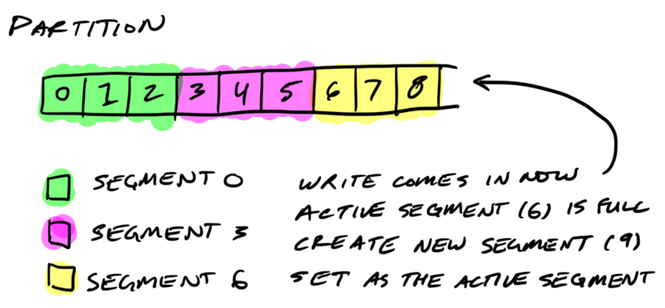
Log is stored on the disk as “segments”
000.log 003.log 006.log
Detail to note:
File names are their starting offsets
Hence you can binary search on file names
Notes:
Binary search (after refering an index) would still be slow
Because we’d still have seek time cost for those searches/jumps
(total 1TB/1kb per message size) would involve just 9 steps..but those 9 would involve seeks!
Segments
https://thehoard.blog/how-kafkas-storage-internals-work-3a29b02e026
Log.roll.ms = max time after which we roll

Slide 18
More on segments
Not a single loong log!
Think of why rail tracks are made of segments?
Because it is easier to delete an old segment rather to look for messages old enough
Reduced contention (we have writers/readers too)
(One could take locks over byte range of file, but that’d be clunky!)
Close one, start new if crossing:
log.segment.bytes
log.segment.ms
Notes:
Binary search (after refering an index) would still be slow
Because we’d still have seek time cost for those searches/jumps
(total 1TB/1kb per message size) would involve just 9 steps..but those 9 would involve seeks!
Segments
https://thehoard.blog/how-kafkas-storage-internals-work-3a29b02e026
Log.roll.ms = max time after which we roll

Slide 19
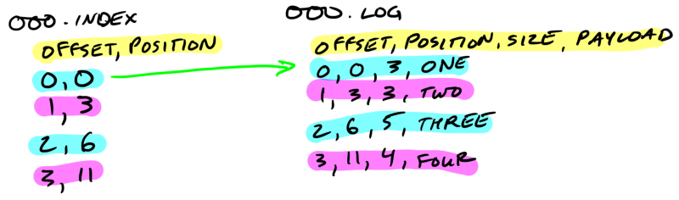
Segments are indexed
Notes:
Why have offset stored in indexed?
See LogSegment.append(...)
Simply nth skipped (size of position which is 4bytes) and reach the nth offset?
Well, not all offsets are stored/indexed. Hence there is a need to binary search inside the index file.
(why not all of them are stored? To save space I guess, that is why we have log.index.interval.bytes and segment.index.bytes)
https://stackoverflow.com/questions/19394669/why-index-file-exists-in-kafka-log-directory

Slide 20
Segments are indexed
Going through the entire segment to find the record at offset X would be inefficient
Records aren’t of the same size hence you can’t just jump
(payloads differ)
Therefore we create an index that tells us where to jump!
Records in the index itself are fixed size and so you can jump in the index
4 bytes for offsets stored as an offset from base offset represented by file name
4 bytes for byte position of where the record starts in the log
Not all offsets are stored
log.index.interval.bytes
log.index.size.max.bytes
Notes:
Why have offset stored in indexed?
See LogSegment.append(...)
Simply nth skipped (size of position which is 4bytes) and reach the nth offset?
Well, not all offsets are stored/indexed. Hence there is a need to binary search inside the index file.
(why not all of them are stored? To save space I guess, that is why we have log.index.interval.bytes and segment.index.bytes)
https://stackoverflow.com/questions/19394669/why-index-file-exists-in-kafka-log-directory

Slide 21
Retention policies

Slide 22
log.cleanup.policy = delete
Retain a window of records
Time (log.retention.ms)
Done by examining the last modified time of each segment
Size (log.retention.bytes)
Start deleting segments till we fall below this limit
After the retention window, you no longer can recreate the current state of the system from the source alone
Segment 1: [+1, -2, -3] Segment 2: [+4 -5]
\__ consumer dies here, comes back up really late
Segment 2: [+4 -5]
\____ starts consuming from +4, reaches incorrect state -1
Used for logs that “ingest” real-time feeds
Notes:
What happens if someone tries to read an offset that got deleted?
SLA for consumers
log.cleanup.policy=[delete, compact]
Now the log isn’t infinite, we’re limited by the disk space we have
So there’s a retention policy = compact/delete and retention intervals/size, for how long to retain the data for?
After which the log is purged
Now if log were a single file, it wouldn’t be fair to delete the log right away after lets say 7 days, since it might have data that is just a few hours late, appended
Ah, simple so we traverse the log and keep deleting messages which have gotten older than 7 days?
This would be time consuming and error-prone
What Kafka does is, split the log into segments. You configure a segment size and after that it’ll roll over to a new segment.
It never deletes the current active segment. Once 7 days pass, it will delete the segment that is older than 7 days
Log.retention.bytes = max size of log, after which clean up starts (and we keep deleting segments, till total size falls below this)
Log.retention.ms = max time after which the log segment is deleted
Log.segment.bytes = max size of segment, after which we roll

Slide 23
log.cleanup.policy = delete
Let’s take an example:
producer rate: 100 MB/per day
log.segment.bytes: 1GB (default)
log.retention.ms: 604800000 (1 week)
10 days to fill 1st segment (100MB per day = 1GB)
A new 2nd segment is created and becomes the active segment
1st segment is still not considered for deletion because the last modified time would be today!
7 days later, 1st segment is deleted
Hence messages would be retained for 17 days!
Notes:
What happens if someone tries to read an offset that got deleted?
SLA for consumers
log.cleanup.policy=[delete, compact]
Now the log isn’t infinite, we’re limited by the disk space we have
So there’s a retention policy = compact/delete and retention intervals/size, for how long to retain the data for?
After which the log is purged
Now if log were a single file, it wouldn’t be fair to delete the log right away after lets say 7 days, since it might have data that is just a few hours late, appended
Ah, simple so we traverse the log and keep deleting messages which have gotten older than 7 days?
This would be time consuming and error-prone
What Kafka does is, split the log into segments. You configure a segment size and after that it’ll roll over to a new segment.
It never deletes the current active segment. Once 7 days pass, it will delete the segment that is older than 7 days
Log.retention.bytes = max size of log, after which clean up starts (and we keep deleting segments, till total size falls below this)
Log.retention.ms = max time after which the log segment is deleted
Log.segment.bytes = max size of segment, after which we roll

Slide 24
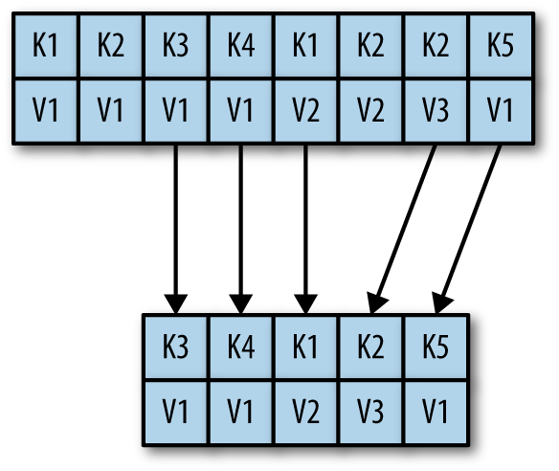
log.cleanup.policy = compact
Retains the last known value for each key
(Hence your messages must be keyed!)
Finer grained per-record retention
rather than coarse grained time-based retention
Used for “long storage”
Compacted logs are where you store results of your processing to later restore your state from
Example:
Our CaaS consumer could push it’s results of computation done over the incoming stream of
operations to a compacted log keyed by userid
(we’ll see an example shortly)
Notes:
See docs over LogCleaner, LogCleanerManager#cleanableOffsets
Why compaction?
“The simple log retention mechanism which throws away old updates will bound space but the log is no longer a way to restore the current state—now restoring from the beginning of the log no longer recreates the current state as old updates may not be captured at all” (this concern only arises once you start thinking about the log bound)
In Kafka, cleanup has two options depending on whether the data contains keyed updates or event data. For event data, Kafka supports just retaining a window of data. Usually, this is configured to a few days, but the window can be defined in terms of time or space. For keyed data, though, a nice property of the complete log is that you can replay it to recreate the state of the source system
eee, log compaction is enabled by using a badly named property:
Log.cleaner.enable
Log compaction ensures that Kafka will always retain at least the last known value for each message key within the log of data for a single topic partition.
(it is to get per-record retention granularity)
Since the current policies we have discussed could cause a key which wasn’t updated for a long time (and is now a part of the oldest segment) which would be deleted, hence we’d have no trace for this key!
By doing this we guarantee that the log contains a full snapshot of the final value for every key not just keys that changed recently
Todo: what threads are involved and how is the process carried out?
Useful to think of having compacted topics for “long storage”
You can have a delete+compact policy as well

Slide 25
Ingest: “CalculateLog” (retention: deletion)
[-1 -2 +3] [-4 +5 +6 +7] [*8 /1]
\__ consumer at offset 1
process local state:
map(userid, result) = {“red”:”-1” }
[-1 -2 +3] [-4 +5 +6 +7] [*8 /1] [*9 +1 -3]
\__ consumer at offset 6
process local state:
map(userid, result) = {“red”:”+13” , “black”: “-6”}
[-1 -2 +3] [-4 +5 +6 +7] [*8 /1] [*9 +1 -3]
(deleted) \__ consumer dies, comes back up, resumes at offset 6
recreates state from “CalculatedLog”
process local state:
map(userid, result) = {“red”:”+13” , “black”: “-6”}
StateStore: “CalculatedLog” (retention: compaction)
[ -1]
[-1 -2 +2 -6 +7 +13]
After compaction
[ -6 +13]
[ -6 +13]
(red represents operations by user A, black represents operations by user B)
Notes:
Maybe lay the three progresses in state over 3 separate slides? This looks too congested

Slide 26
How does compaction work?
Let’s take an example of a log having segment size = 2 messages (just for ex.)
Sections:
Cleaned
Dirty (cleanable/uncleanable)
Uncleanable consists of:
Active segment
(newest segment currently being
written to)
Segments with last modified time
less than min.compaction.lag.ms
← cleanable dirty section → active
[k1:v1 k1:v2] [k1:v3 k1:v4] [k1:v5]
Built keyOffsetMap = {k1 : 3}
← cleaned section (cs) → active
[] [k1:v4] [k1:v5]
Later,
← cs → ← cds → active
[] [k1:v4] [k1:v5 k1:v6] [k1:v7]
Built keyOffsetMap = {k1 : 5}
← cs → active
[] [] [k1:v7]
Notes:
See LogCleaner#cleanInfo, RecordFilter
OffsetCheckpointFile (see /tmp/kafka-logs/cleaner-offset-checkpoint) has (topic name, partition, checkpoint offset)
Finding range of cleanable offsets firstDirtyOffset=8 firstUncleanableOffset=8 (LogCleanerManager)
Swapping groups multiple segments into one as long as they fit together, creates a new xxx.log file, and swaps this one in by renaming the actual logs xxx.log.deleted
Another thread (some other component) at a later point actually deletes these “.deleted” suffixed files

Slide 27
How does compaction work?
Algorithm:
Traverse the cleanable dirty section
Build a map(key, lastestOffset) on the way
Start traversal from the cleaned section to end of cleanable dirty section
Check for each record on the way:
If it’s key exists in the map with > offset, skip it, since it means it has a newer value later in the dirty section
Else copy this record into a new replacement segment
Notes:
See LogCleaner#cleanInfo, RecordFilter
OffsetCheckpointFile (see /tmp/kafka-logs/cleaner-offset-checkpoint) has (topic name, partition, checkpoint offset)
Finding range of cleanable offsets firstDirtyOffset=8 firstUncleanableOffset=8 (LogCleanerManager)
Swapping groups multiple segments into one as long as they fit together, creates a new xxx.log file, and swaps this one in by renaming the actual logs xxx.log.deleted
Another thread (some other component) at a later point actually deletes these “.deleted” suffixed files

Slide 28
Scaling the log
Notes:
If the log is so central and such a pillar for the entire enterprise, it needs to be scalable.
There cannot be just one log to which everyone writes and everyone reads from else you’ll be limited by the resources (network, disk, memory, cpu) of the single broker hosting the single log
- partition the log for horizontal scalability (low hanging fruit)
- page cache
- zero copy
- optimizing throughput by batching
https://www.quora.com/Why-does-Kafka-scale-better-than-other-messaging-systems-like-RabbitMQ
Smart broker vs dumb consumer
Dumb broker vs smart consumer
https://content.pivotal.io/blog/understanding-when-to-use-rabbitmq-or-apache-kafka
Message deletion is not upon consumption, but on time
Many such factors in Kafka that don’t require bookkeeping, hence makes it faster

Slide 29
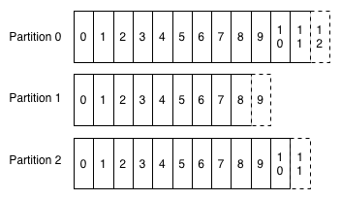
Partitioning - more places to write to and read from!
Notes:
Hence natural solution is to have more logs to write to and read from :)
For ex. if our throughput when writing to a single log was x megs/sec
Now if number of logs increase two fold let’s say (each being on a separate host), then our throughput also increases two fold
Hence throughput linearly scales with Kafka cluster size(not directly with no of partitions, since multiple partitions may be hosted on
The same host)
Q: Is there any advantage of having multiple partitions on the same broker?
Messages now could be written into any of the partitions
If the producer wants, it could choose which partition to write to (mostly done using a message key%no of partitions)
Since there is no communication between the shards (i.e brokers hosting the partitions), each partition is ordered but there is no global ordering
No of partitions is your unit of parallelism
Choosing it is hard (just like GC tuning is a hard task)
More on partitions later... (replicated, leader election, etc)
Todo: properties

Slide 30
Partitioning - more places to write to and read from!
By having a single log we were limited by a single broker’s:
CPU, Disk, Memory, Network interface capacity
Partition the log and evenly distribute them over a cluster of brokers (horizontally scale)
Load could then be distributed by any partitioning strategy on producer side, for example:
Distribute “CalculatorOperations” by (userid % num of partitions)
Remember:
Records are only time-ordered within a partition.
Hence records belonging to same entity must go in the same partition!
P0: (userA, +1, t0) (userB, -2, t1) P1: (userA, +4, t1) → consumer might consume from P1 first!
Notes:
Hence natural solution is to have more logs to write to and read from :)
For ex. if our throughput when writing to a single log was x megs/sec
Now if number of logs increase two fold let’s say (each being on a separate host), then our throughput also increases two fold
Hence throughput linearly scales with Kafka cluster size(not directly with no of partitions, since multiple partitions may be hosted on
The same host)
Q: Is there any advantage of having multiple partitions on the same broker?
Messages now could be written into any of the partitions
If the producer wants, it could choose which partition to write to (mostly done using a message key%no of partitions)
Since there is no communication between the shards (i.e brokers hosting the partitions), each partition is ordered but there is no global ordering
No of partitions is your unit of parallelism
Choosing it is hard (just like GC tuning is a hard task)
More on partitions later... (replicated, leader election, etc)
Todo: properties

Slide 31
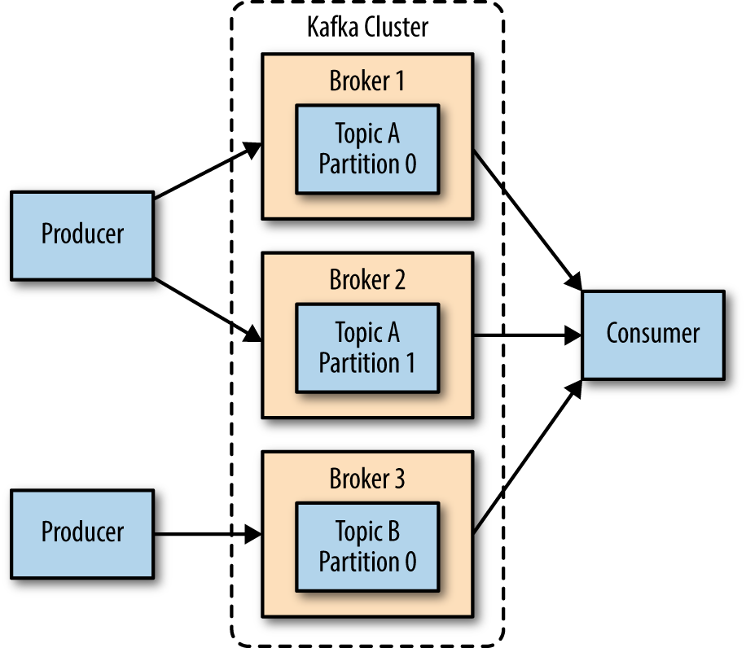
are split into of a number of
are stored as
Topics
Partitions
Log Segments
Notes:
Data modelling in Kafka
Topic config parameters?

Slide 32
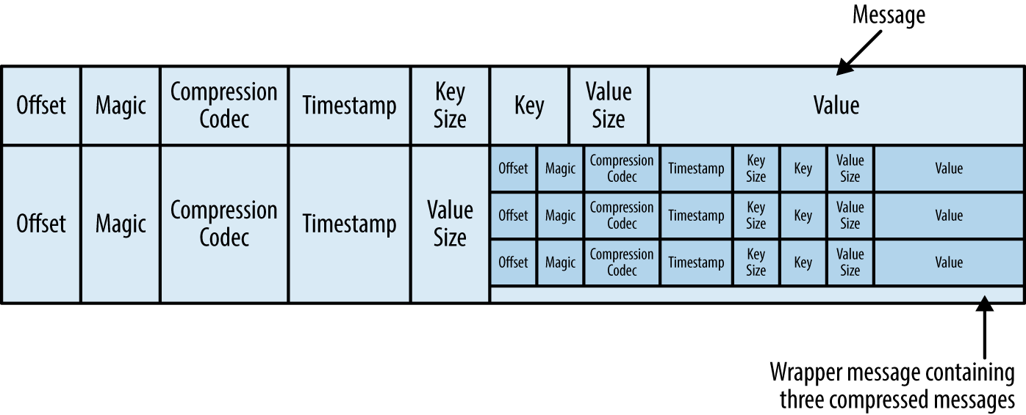
End-to-end batching and compression
*Only for visualization, actual message format here
Notes:
LogOffsetMetadata -- assigned by broker
DefaultRecordBatch#iterator -- compressedIterator, CompressionType enum
MemoryRecords are written to FileRecords in LogSegment#append
MemoryRecordsBuilder#append (gets nextSequentialOffset)
DefaultRecord is the serialization format of the broker (this is the format in which messages are stored on disk)
------^ This was broker side
See ProducerBatch for usage of MemoryRecords on producer side
MemoryRecordsBuilder’s ctor itself wraps the outputstream by a compressed type stream :)

Slide 33
End-to-end batching and compression
Producer sends are batched (batch.size in bytes, linger.ms)
This leads to larger network requests but lesser trips
Even on the broker, batches are stored as it is and hence we get large sequential disk operations
Consumer fetches are also batched (fetch.min.bytes, fetch.max.bytes, fetch.max.wait.ms)
Producers also can send their <key, value> compressed (compression.type)
These records are finally decompressed by Consumer
Q. But we still persist to disk, wouldn’t it be nice to hold in memory:
recent write expecting it to be consumed soon?
recent read to be read again by a slower consumer?
Notes:
LogOffsetMetadata -- assigned by broker
DefaultRecordBatch#iterator -- compressedIterator, CompressionType enum
MemoryRecords are written to FileRecords in LogSegment#append
MemoryRecordsBuilder#append (gets nextSequentialOffset)
DefaultRecord is the serialization format of the broker (this is the format in which messages are stored on disk)
------^ This was broker side
See ProducerBatch for usage of MemoryRecords on producer side
MemoryRecordsBuilder’s ctor itself wraps the outputstream by a compressed type stream :)

Slide 34
But we still persist to disk, isn’t that slow?
Disks love large linear reads and writes due to their mechanical nature!
We batched writes/reads, but there might be poor disk access patterns
Write requests to sector 200 then 180 then 210
How about reordering them to 180...200...210 minimising seek time?
Modern OS employ kernel I/O schedulers that keep requests queued for a short while & then:
Sort them
Merge adjacent sector requests
Issue them to disk
Notes:
Batching gives us large writes/read requests for disk
But still we could have poor disk access pattern
Someone gave a write request to sector 200 then later someone gave it for sector 100
Wouldn’t it be better if we could reorder these writes? I/o scheduler does that
But for that, it needs many I/o requests?
How do we hold them up? Page cache
The key is to think about I/o requests not for the same sectors, but “sectors around”
Our writes go to page cache
Page cache is flushed by OS (depending on ratio of dirty pages, etc)
Try this out
Write everything to page cache, then flush, and hopefully we should have only one i/o request

Slide 35
Leverage the Page Cache
Modern OS employs all free memory to cache disk writes/reads
Which means a recently written file when read is served from cache and may not even be written to disk yet!
Therefore a fast enough consumer would cause no disk activity!
OS has background threads dedicated to flushing dirty pages to disk
Q. But what if the broker dies before flushing to disk?
Durability vs Throughput
If you want broker explicitly flushing, configure:
log.flush.interval.ms, log.flush.interval.messages
(less recommended, rather rely on brokers holding replicas)
Notes:
http://web.archive.org/web/20160518040713/http://www.westnet.com/~gsmith/content/linux-pdflush.htm
pdflush got replaced by bdi-flush threads
Show dirty pages (dd command)
Call sync
None dirty
https://www.thomas-krenn.com/en/wiki/Linux_Page_Cache_Basics

Slide 36
Page Cache vs In-Process Cache
Page cache remains warm across process restarts!
No GC penalties, since page cache is not part of the JVM heap
Lesser memory overhead, no Java object headers
Side note:
Some databases do Direct I/O having their own caching mechanisms in place bypassing the page cache
Support for O_DIRECT has been added in JDK 10

Slide 37
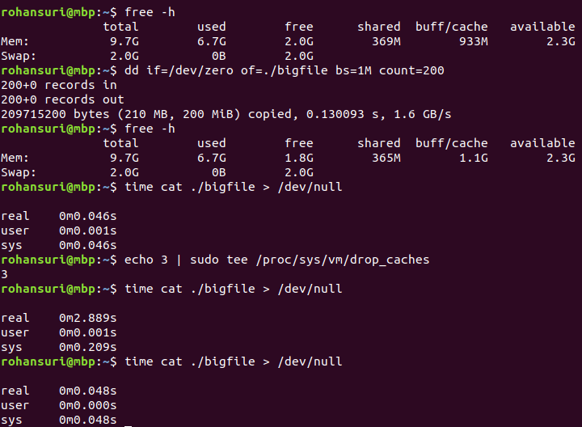
Notes:
Old speaker notes:
Cool, we’ve increased throughput, what are we limited by next?
The disk.
The disk is notorious for being slow, but really is it? Yes and no
It all depends on the usage pattern
Disks are really good at doing large sequential reads and writes, so good that they even beat random access main memory writes!
Hence basically we want to hold our writes before they go to disk
And since reads are going to be frequent we’ve got to keep them in memory
And really our writes/reads are naturally sequential (because we have a write-ahead append only log)
But how do we make sure these are large? We batch
To batch writes we’d keep them stored let’s say as List<Records> (while putting the record we do list.size() and set that as the record offset)
And after a certain interval, simply write them to disk
Let’s think about the reads
So if a consumer asks for records from offset 5… then we read maybe a lot of them (batch size) and put them in a cache
Let’s think an in memory cache so maybe imagine Map<Offset, Record>
Well all sorts of questions arise then:
When to remove an entry from our cache?
Locked access when adding a new entry
Moreover JVM is notorious for getting slow as you fill up the heap space -- GC penalties start incurring
What do we do? Simple we don’t maintain an in-memory cache and let the OS do it for us, how?
The Modern OS already actually uses all free memory as the disk cache (page cache maintained in the kernel space) -- (see “free -m” cached section)
Hence all our writes/reads actually go to this cache which acts as a sponge to soak all writes/reads
The OS later does a fsync that writes to disk (still worry about the driver controller caches)
Is less-coding/simpler broker design the only advantage we get by this? No there’s more:
- Page cache remains warm even after process restarts! (no cold starts)
- Lesser memory since a Java object takes some header space (imagine the header space taken by the map object, each of the entry objects, each of the Offsets, each of the Records)
Of course that means your writes lie in the memory until they’re flushed to the disk by the OS
You can configure the flush interval (todo) and hence trade off between durability and throughput
It can do read-ahead and write-behind optimisations meaning prefetching large blocks as well as grouping smaller writes into large physical writes (all of this only being leveraged since writes/reads are linear which are predictable by OS)
Pages marked dirty, dirty list, etc https://stackoverflow.com/questions/40034642/are-file-reads-served-from-dirtied-pages-in-the-page-cache
Disk writes/reads are actually in competition with the network bandwidth (we want their rates to be as close as possible for total utilization)
Remember all of this because of our usage pattern! (page cache fetches 4KB at a time, hence we expect all of that to be read)
This is also why Kafka is able to retain the messages for a longer period
https://manybutfinite.com/post/page-cache-the-affair-between-memory-and-files/
-------------------------------------------------------------------------------------------------------------------------------------------------------------------------------
Free memory is wasted memory
Hence the OS uses it as the disk cache

Slide 38
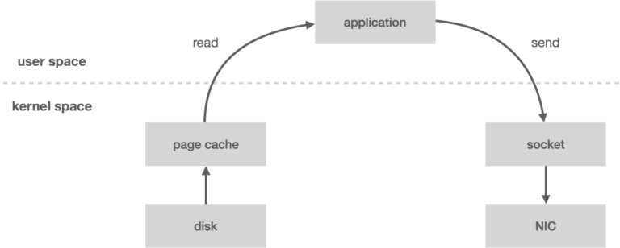
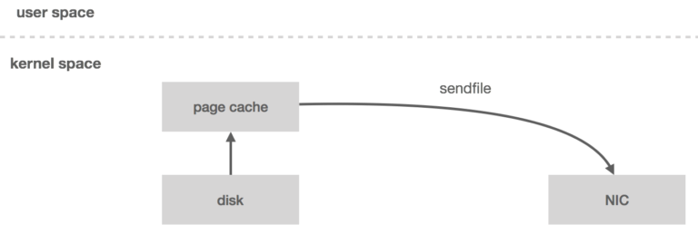
Zero copy using Linux sendfile(...)
4 copies
4 context switches
2 copies (no copy in user space!)
2 context switches
Notes:
Zero copy from page cache really to network
In the usual case, kernel reads the data off of disk and pushes it across the kernel-user boundary to the application, and then the application pushes it back across the kernel-user boundary to be written out to the socket (4 copies)
Each time data traverses the user-kernel boundary, it must be copied, which consumes CPU cycles and memory bandwidth
(CPU cycles? Load/store instructions for copying data from kernel space in RAM to user space (since they are two different processes))
Standardized binary message format across the producer, broker and consumer,
i.e when reading data from the disk and sending it over wire, the message is sent as it is on the disk, hence we’re able to cut down on the intermediate copies created (which are unnecessary) by leveraging the kernel APIs (system calls)
Kafka has its own metadata along with the message that it understands, but it does not interpret the message and lets that be as bytes. Hence the message could be GPB, XML, JSON, etc
This combination of pagecache and sendfile means that on a Kafka cluster where the consumers are mostly caught up you will see no read activity on the disks whatsoever as they will be serving data entirely from cache (show using iostat)
(I know this does not belong but something I just remembered: if you want durability you opt for more replicas rather than decreasing log flushing interval)
https://en.wikipedia.org/wiki/Zero-copy
https://www.ibm.com/developerworks/library/j-zerocopy/index.html

Slide 39
Zero copy in user space
A simple read-storage-then-send-over-network doesn’t require messages to be read in user space
Some messaging systems can’t leverage zero copy because they read the message in user space for bookkeeping
(for ex. to read message ID and maintain a map of acknowledgements)
This system call is already exposed by JDK
FileChannel # transferTo(...)
Quoting the docs:
“This method is potentially much more efficient than a simple loop that reads from this channel and writes to the target channel.Many operating systems can transfer bytes directly from the filesystem cache to the target channel without actually copying them.”

Slide 40
How data consumption scales
Notes:
Usually the use case of messaging systems has been for flow control, where producer writes too fast and consumer is unable to catch up.
Why? Because typically consumers are involved in doing some high latency work -- computation or database writes
So we want to have multiple instances of the same consumer and for all of them to share the data being produced
So let’s see how this happens with Kafka

Slide 41
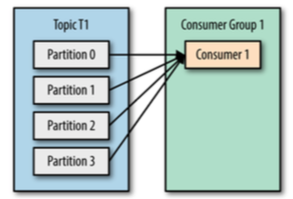
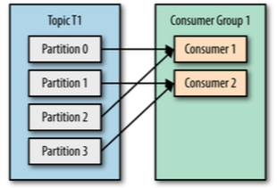
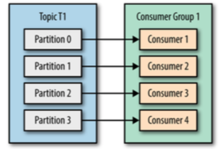
Consumer Groups
Notes:
All consumers are always part of a consumer group
And Kafka assigns a subset of partitions for that topic (being consumed) to each consumer in a group
So we add more consumers in a group, that then start sharing the load of the topic
If we have more no of partitions than consumers, then later it is easier to scale when load increases, since we can add more of them
(adding consumers later is easy, adding more partitions at runtime is hard, since there might be message ordering that could get distributed,
If we expected a sequence of orderCreated, orderValidated, orderShipped, for a particular orderId, then we want all these linked events to go to the same partition on producer side and hence be consumed in order from the same partition on consumer side)
If we change number of partitions at runtime and if the orderShipped was yet to happen, and it got into a different partition, then the consumer this time who got this would be different and may not be having the local state (gathered from the previous order events) that is required to process this last orderShipped event)
Assignment of partitions amongst consumers of a group is left to consumer themselves, the first consumer that joins a group is the leader and is asked to assign the partitions to all consumers
JoinGroupRequest

Slide 42
Consumer Groups
Rate of production is usually more than consumption
Therefore we got multiple consumers instances
In Kafka all of them belong to the same “consumer group” by having the same group.id
Hence sharing the load of a topic
Every partition is owned (hence consumed) by one and only one consumer in a consumer group
Q. How are partitions assigned?
The first consumer to join a consumer group is the leader of the consumer group
An assigned broker GroupCoordinator sends the leader a list of all alive consumers and asks it for partition assignment

Slide 43
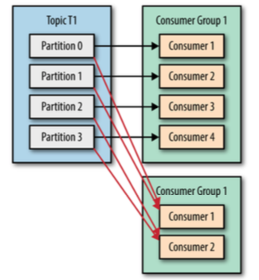
Consumer Groups
CalculateTopic
CalculatorConsumerGroup
LargeOperationsTrackerGroup

Slide 44
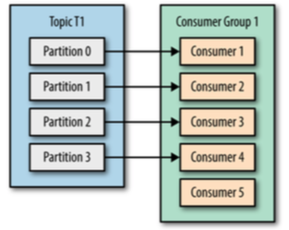
Consumer Groups
num.of.partitions in a topic is the limit of active consumption
Consumer 5 is initially idle
Later if any of the other consumers go down, after a partition rebalance it would help share the load once again
Notes:
Is there any advantage of having the extra consumer? Yes, partition rebalance, when any of the others fail

Slide 45
Partition Rebalance
When does a GroupCoordinator trigger a rebalance?
consumer joins/leaves a group
addition/removal of topic partitions
consumer crashes/is stuck (GC or some other liveness/deadlock in application logic)
Rebalances are seamless
Keep our consumer group highly available and scalable
They are however undesirable since:
During a rebalance no consumer in a group can make progress
(their offsets requests to move ahead would be rejected)
Post rebalance a consumer could be assigned an entirely new partition for which it has no “current state”
Notes:
Moving partition ownership from one consumer to another
This is tricky, should be covered in depth! With all the related properties
Allows safely adding/removing consumers
Group coordinator (one of Kafka brokers) that listens for heartbeats from the consumers in a group (could be diff for diff consumer groups)
If it doesn’t get the heartbeat, it triggers a rebalance
Rebalance is expensive:
During rebalance, consumers can’t consume messages, so there’s a short window of unavailability
Additionally, depending on use case, think about it, if consumer got assigned a new partition, will it have to consume everything from the start gathering the state, slowing the app down?
Hence partition rebalances are not favourable, but yes the handling of them is graceful
session.timeout.ms - how long will the group coordinator will wait for a heartbeat before considering a consumer dead
heartbeat.interval.ms - how often the consumer will send heartbeats to group coordinator
auto.offset.reset - if you started reading a new partition for which you don’t have a committed offset, should you read from earliest or latest?
ConsumerRebalanceListener, onPartitionsAssigned/Revoked
After a rebalance, consumers consume from the last committed offset for a partition
https://cwiki.apache.org/confluence/display/KAFKA/KIP-62%3A+Allow+consumer+to+send+heartbeats+from+a+background+thread

Slide 46
Partition Rebalance
Let’s take an example:
Topic “Calculate” with 2 partitions
Ops by user “foo” go to p1 & “bar” go to p2
2 consumers with state stores:
C1 assigned p1: {foo: +3}
C2 assigned p2: {bar: -1}
C2 goes down
After rebalance, C1 got assigned p1, p2 both
C1’s current state store: {foo: +3, bar: 0}
If C1 can access C2’s state store, it copies that over and then starts consuming p2 from where C2 left (How does it resume? We’ll see next…)
Else, it’ll have to consume p2 from the start
Notes:
StoreChangeLogger (Kafka Streams -- when storing output to Kafka itself)
StreamThread
CG-T-Pnumber

Slide 47
Partition Rebalance
Properties governing a rebalance (consumer side configs)
heartbeat.interval.ms
A periodic heartbeat sent to broker in the background to indicate consumer liveness
session.timeout.ms
If no heartbeats are sent before this timeout, coordinator triggers a rebalance
Must be between broker’s group.min.session.timeout.ms, group.max.session.timeout.ms
max.poll.interval.ms
Upper bound between successive invocations of poll()
This is to guard against liveness, where heartbeats are being sent but consumer is making no progress

Slide 48
How Kafka tracks consumers
Notes:
For every consumer group, we need to track how far it’s consumers have consumed any of the subscribed TopicPartitions
This is so that consumers could resume after crashes or take each other’s places after rebalances
https://www.slideshare.net/jjkoshy/offset-management-in-kafka
http://wanwenli.com/kafka/2016/11/04/Kafka-Group-Coordinator.html
Super important thought:
If we do allow out-of-order processing, then we need to track individual, in-flight messages, which is what per-message acks allow us to do. In this case, the system starts to look less like a log and more like a message queue

Slide 49
Saving offsets
Consumer updates its offset for all assigned TopicPartitions by “committing” its current offsets
(OffsetCommitRequest)
Consumer could:
let auto commit happen as part of every call to poll()
(enable.auto.commit, auto.commit.interval.ms)
OR
explicitly invoke commit(...) APIs
Notes:
Group metadata manager
GroupCoordinator#handleFetchOffsets

Slide 50
__consumer_offsets topic
How are these offsets stored?
Eat your own dog food!
An internal compacted topic containing records:
Key: <consumer-group, topic, partition>
Value: last offset consumed
After consumer crashes/rebalances a newer consumer could take over by getting the
“where to resume?” question answered by consuming this internal topic
(OffsetFetchRequest)
Notes:
Group metadata manager
GroupCoordinator#handleFetchOffsets

Slide 51
__consumer_offsets topic
CalculatorGroup-
CalculateTopic-0
Offset: 6
CalculatorGroup-
CalculateTopic-0
Offset: 14
LargeOperationsTrackerGroup-
CalculateTopic-0
Offset: 12
CalculatorGroup-
CalculateTopic-0
Offset: 37
….
After compaction....
Offsets Cache
LargeOperationsTrackerGroup-
CalculateTopic-0
Offset: 12
CalculatorGroup-
CalculateTopic-0
Offset: 37
CalculatorGroup-Calculate-Topic-0 | 37
LargeOperationsTrackerGroup- CalculateTopic-0 | 12
GroupCoordinator maintains an “OffsetCache” serving OffsetFetchRequests, OffsetCommitRequests
It builds this cache first time around by consuming the topic itself
Notes:
Group metadata manager
GroupCoordinator#handleFetchOffsets

Slide 52
Demo
Notes:
Start broker, connecting to zk
zk is used for
*brokers to discover each other -- cluster membership
*topics - what topics exist, who’s the leader for them, any config overrides
* ISR
Create topic calculateTopic with 2 partitions, no replicas
./bin/kafka-topics.sh --zookeeper localhost:2181 --create --topic calculate --partitions 2 --replication-factor 1
(you need not create it beforehand, if producer writes to a non-existent topic, a new one gets created)
A single producer, producing operations (take them from command line)
User “foo”, “bar” ops go into diff partitions
Show DumpLogSegments how both went to two different partitions (log storage)
Let’s start consuming the operations
Initially only one consumer, both partitions get assigned to the single consumer
Let’s kill the consumer, produce more operations and see how much it is lagging by
Let’s start the consumer again, and it then covers the lag
Let’s increase rate of consumption, have 2 consumers now, partition assignment
Kill one and show how the other takes over
(since we use auto commit for EchoConsumer, all we care to show is that the future produced operations are being printed on console
By different consumers now. We don’t care about restarting in rebalance listeners)
Consumer crashing, coming back up and resuming (state store topic -- easier in Kafka streams)

Slide 53
What’s next
Making the log fault-tolerant
by replicating the log over multiple brokers in the cluster
consensus between replicas, n+1 failures tolerant
Message persistence guarantees for producers
at most once, at least once, exactly once (idempotent producers)
Message processing semantics for consumers
at most once, at least once
Transactions in Kafka
2 phase commit in Kafka
Tx: producing results to an output topic + committing offsets for input topic
Exactly once semantics
built using transactions + exactly-once producers
Kafka as a streaming platform
Notes:
In case of IBM MQ what we worry about is re-processing the same message from the queue multiple times
Since in 1PBE, we have say reading from MQ -> computing -> putting results to DB -> putting output message on output Q -> committing input MQ
This putting results to DB must be idempotent.
What about putting the message to output queue? What if that fails?
Well, it could fail under various conditions right?
Maybe the queue actually wrote this output message, but the confirmation(ack) got lost on it’s way back?
We rollback the tx, and reconsume from input Q…
And produce a duplicate message on the MQ!

Slide 54
Thank you

